Slide 1
Financial Markets and Securities
10
Notes:
Pre-class music: “Secure Horizons” by Guttermouth (See Tip #357)
In this song, Guttermouth suggests a pretty good strategy for securing a stable financial future: diversifying. You can play this song for your students to introduce the lecture on financial markets and securities, and discuss Guttermouth’s investment plan.

Slide 2
Previously
Loanable funds markets channel funds from savers to borrowers
Supply of loanable funds: household savings
  Suppliers provide the funds for firms to expand through investment
Demand for loanable funds: firms borrowing to invest
Equilibrium in this market determines the level of savings, investment, and interest rates.
Savings → Borrowing → Investment → Growth

Slide 3

Big Questions
How do financial markets help the economy?
What are the key financial tools for the macroeconomy?

Slide 4

How Do Financial Markets Help the Economy?
Financial intermediaries
  Firms that help channel funds
  from savers to borrowers
  Example: banks
Banks
  Private firms that accept deposits and extend loans
Importance?
  Banks are at the center of financial markets
  Banks help connect borrowers (demanders) with the savers (suppliers)
Notes:
Lecture notes:
Of additional importance, consider what happens when financial markets break down.
In 2007, several U.S. financial institutions began faltering.
In September 2008, Lehman Brothers, a financial intermediary with over $600 billion in assets, went bankrupt.
These financial difficulties foreshadowed the deep recession that lasted through July 2009.

Slide 5
Practice What You Know—1
What role do banks play in financial markets?
  Banks affect the money supply by minting new currencies
  Banks set the interest rate
  Banks sell stocks to the government
  Banks act as financial intermediaries between borrowers and savers
Notes:
Clicker question:
Correct answer: D, Banks act as financial intermediaries between borrowers and savers
Banks help connect borrowers (demanders) and savers (suppliers) of funds.
This helps encourage trade and keeps the financial markets active.

Slide 6
Indirect versus Direct Finance
Indirect finance
  Occurs when savers deposit funds into banks, and banks then loan these to borrowers
  Banks pay lower interest rates to savers than they charge borrowers in order to earn profit
Direct finance
  Firms sell a security (stock or bond) directly to the public in exchange for funds
  Security provides future income and/or gives part ownership of the firm
Notes:
Lecture notes:
Indirect finance:
The form of finance you are probably most familiar with is through banks (or other financial third parties).
Banks collect savings from many sources and convert these to loans, as a channel for loanable funds
Banks charge a higher rate of interest to borrowers than they pay to savers in order to make a profit.
This is indirect finance.
Direct finance:
It is also possible for firms to go directly to individuals for their funds.
To undertake this direct finance, firms sell a security (like a bond or stock) directly to the public in exchange for funds.
In direct finance, lender-savers purchase a financial security that yields future income and/or gives them ownership of a firm.

Slide 7
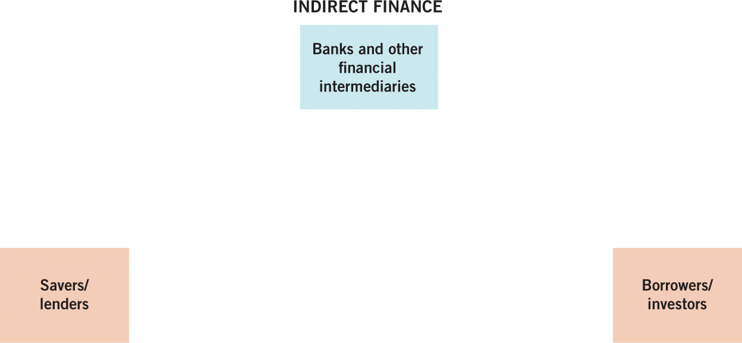
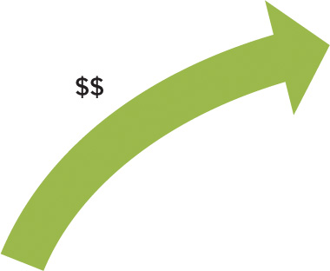
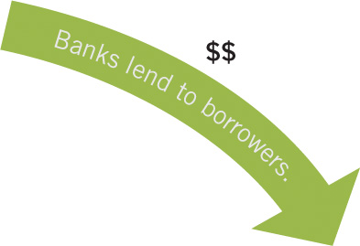
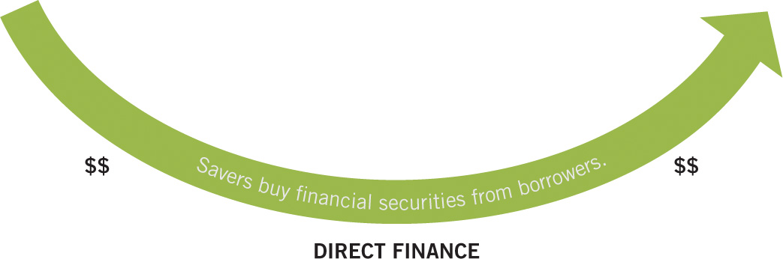
Direct versus Indirect Finance
Notes:
Image: Animated Figure 10.1
Lecture notes:
The figure shows how banks are financial middlemen with indirect finance.
Lecture tip:
Click through the slide to reveal each part of the figure.
The figure starts out with just savers/lenders.
First click: Borrowers/investors
Second click: Direct finance
Savers buy financial securities from borrowers
Third click: Indirect finance
Savers deposit funds in bank
Banks lend to borrowers

Slide 8
Practice What You Know—2
Which is an example of indirect finance?
  Ashley closes her account at Green Bank.
  Ethan deposits money in Blue Bank, and Jenna takes out a loan from Blue Bank.
  Lindsay buys a bond from a large pharmaceutical company.
  Derek buys 100 shares of stock at the initial public offering of a company.
Notes:
Clicker question:
Correct answer: B, Ethan deposits money in Blue Bank, and Jenna takes out a loan from Blue Bank.
Indirect finance is when banks act as intermediaries between lenders and borrowers.
Ethan did not directly loan his money to Jenna, but the bank needs savers like Ethan so it can lend money to Jenna.

Slide 9
Financial Tools
What financial tools facilitate exchange between savers and borrowers?
  Bonds
  Stocks
  Treasury securities
  Home mortgages
  Private sector securities (created by securitization)
Notes:
Lecture tip:
The remainder of the slides explain in detail each of these financial tools.

Slide 10
Bonds
Bonds are used by large established firms when they need an infusion of money.
  Securities are issued and sold to the public.
  This is an example of direct finance.
  Funds generated are used for investment.
  Bonds are a formal IOU: A contract specifying who owes how much and a date for payment
Notes:
Lecture notes:
In exchange for the securities, people trade funds to the firm, which are turned into investment.
This is direct finance: the firm goes directly to the public to borrow.
Lecture tip: This is a good time to remind students of the difference between the term investment used by the general public and investment as used by economists.
Investment used by the general public usually refers to purchases of securities.
Purchasing securities is actually savings as defined by economists, which is then used to finance investment activities (purchases of capital).

Slide 11
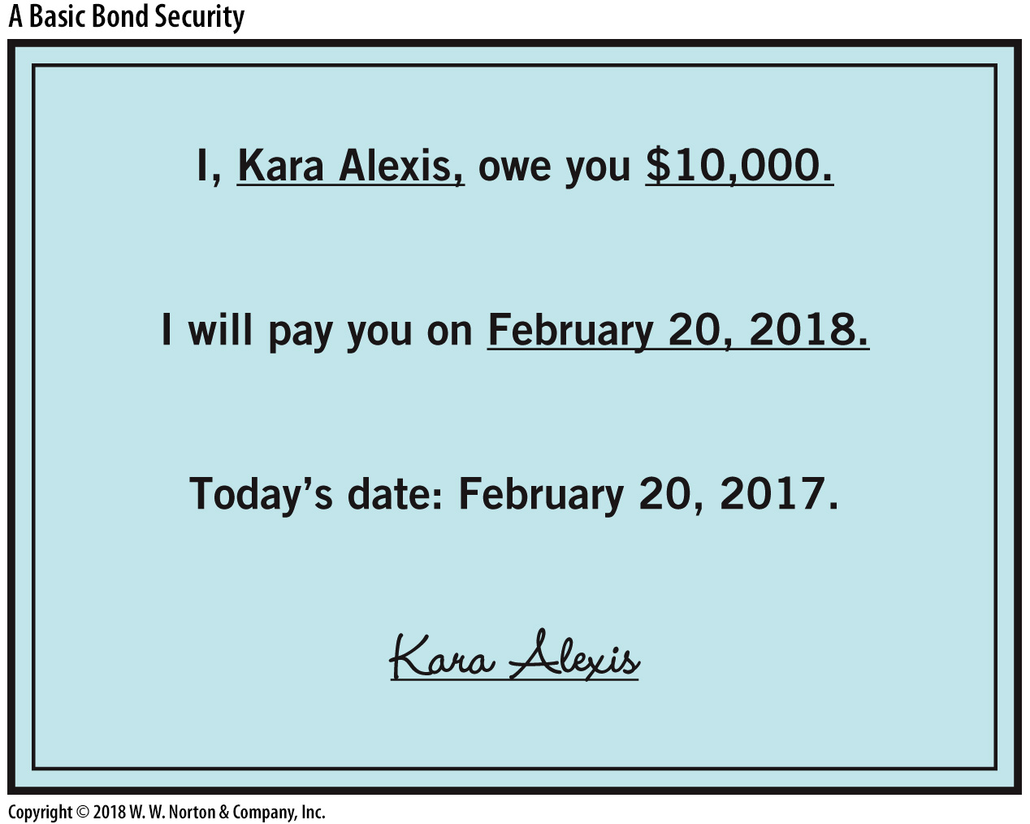
Bond as a Formal IOU
Information on Every Bond:
Name of borrower
Repayment date (Maturity date)
Amount due at repayment
(Face value)
Notes:
Image: Figure 10.2
Lecture notes:
Suppose you need to borrow money from a friend. To formalize your agreement, you decide to draw up a contract like the one presented in here.
This is the contract you sign with your friend.
Notice that your contract has three important pieces of information on it:
your name (you are the borrower)
the repayment date
the amount borrowed.
Lecture tip: You can change the date in the bond to the day you’re teaching the material!

Slide 12
Information on a Bond
Maturity date
  Repayment date
Face value (or par value)
  Value of the bond at maturity (amount due at repayment)
  Maturity date and face value are set at inception
Dollar price
  Price at inception
  Dollar amount at which the bond is originally bought and sold
Notes:
Lecture notes:
What is not set is the loan amount.
You and your friend have to come to an agreement as to how much she will loan you in exchange for the promise that you will pay her $10,000 when the bond matures.
When you do this, you are just agreeing to the price of the bond.
To distinguish this price from the bond price at later dates, we will call this the price of the bond at inception.

Slide 13
Interest Rate Formula
Bond buyers (savers)
  Want the highest interest rates (highest return)
  Want to pay the lowest possible price at inception
Bond sellers (lenders)
  Want to sell bonds at the lowest interest rate possible
  Want to sell the bonds at an inception price that is very close to the face value
Notes:
Lecture notes:
Notice that the dollar price dictates a particular rate of return or the interest rate on this loan. The interest rate is the percentage change in the value of the bond over the course of the year.
In the financial news, bonds are typically listed by their interest rate. If this is the case, you can easily determine the dollar price of the bond by working through the above formula in reverse.
As a borrower, you want to sell your bonds for as high a price as possible, which means you want to pay as low an interest rate as possible for your debts.
As a lender, you want to buy your bonds for as low a price as possible, so you’re earning the highest possible interest rate on your savings.

Slide 14
Bond Principles
The dollar price of a bond determines its interest rate (and vice versa)
The dollar price and interest rate of a bond have an inverse relationship
Consider the following table:
A $10,000 bond is being offered
If the bond is bought at <$10,000
the interest rate is higher
Dollar Price | Interest Rate
$9,000 | 11%
$8,000 | 25%
$7,500 | 33%
$5,000 | 100%
Notes:
Lecture notes:
If a $10,000 bond is offered, this means the bond will pay $10,000 at maturity.
The table in the right corner shows interest rates implied by different dollar prices of a $10,000 bond.
As the price of the bond falls, the interest rate (rate of return on the bond) rises.
This is beneficial for the bond buyer (saver) and not the bond seller (lender).
The relationship between the dollar price and interest rate of a bond is deterministic relationship; it is not coincidental.
Thus far, it has been assumed that bonds offer only one repayment option: the face value is repaid in full at maturity.
This type of bond is called a zero-coupon or discount bond.
However, most corporate bonds also offer periodic interest payments throughout the life of the bond, but that type of bond is not covered in this chapter.

Slide 15
Practice What You Know—3
You buy a $10,000 Microsoft bond for $7,500; what is your rate of return after 1 year?
  50%
  33%
  75%
  25%
Notes:
Clicker question:
Correct answer: B, 33%
Remind students that the rate of return (or interest rate) is calculated as:
Interest rate = R = (face value - initial price) / initial price
So, in this example:
33% = ($10,000 - $7,500) / $7,500

Slide 16
Practice What You Know—4
The interest rate on a bond is:
  paid by the buyer to the seller.
  equal to the dollar price of the bond adjusted for inflation.
  directly related to the dollar price of the bond.
  inversely related to the dollar price of the bond.
Notes:
Clicker question:
Correct answer: D, inversely related to the dollar price of the bond.
Suppose there is a $1,000 bond.
If you buy it at a low price of $750, the interest rate is high at 33 percent.
If you buy it at a high price of $900, the interest rate is lower at 11 percent.
Lower priced (with a higher interest rate) bonds are usually riskier.

Slide 17
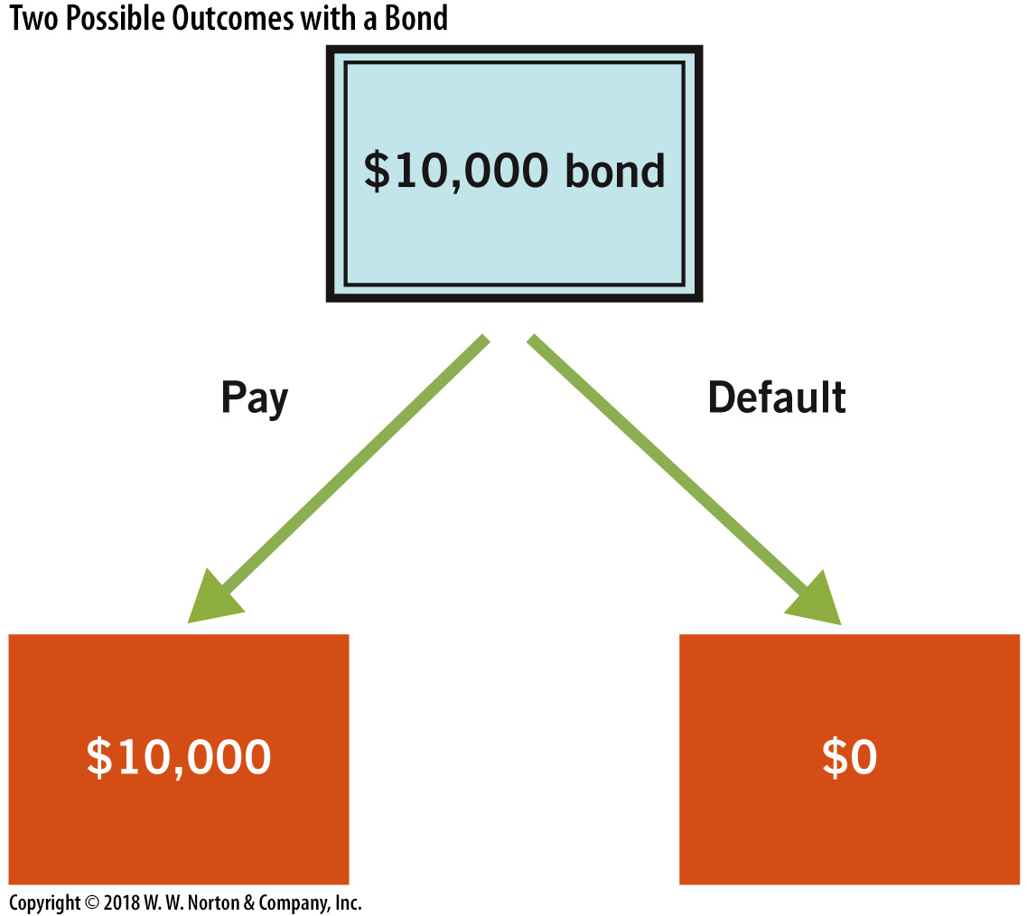
Default Risk—1
Two possible outcomes for the bond:
  The borrower pays maturity value of the bond to lender.
  The borrower defaults on the loan (lender gets $0 back).
Notes:
Image: Figure 10.3
Lecture notes:
With a bond, both the maturity date and the face value are certain. Thus, there are only two possible outcomes if a bond owner holds the bond until maturity:
The borrower will pay the face value
The borrower will default.
The major concern of a bond owner is whether the bond will pay off.
The bond owner just has to estimate the possibility that the borrower will default.
The key risk of holding a bond is default risk, the risk that the borrower will not repay the bond.
Since there are only two possible outcomes, default risk is the primary concern of a bond owner.

Slide 18

Default Risk—2
Default risk
  The risk that the borrower will not pay off the bond
  The greater the risk of default, the lower the price (and higher the interest rate) of the bond
Bond Principle 3:
  Bond interest rates rise with default risk
Notes:
Lecture tip:
You can bring up the following example during your lecture:
You are trying to sell bonds to finance your business.
If your friend really trusts you and believes your business will succeed, she might buy your $10,000 bond for $9,000.
This price means you pay her 11 percent interest for the use of her funds for a year.
On the other hand, if your friend is skeptical about either your integrity or the prospects for your business succeeding, she may only be willing to pay you $8,000 for your $10,000 bond.
This means you will pay 25 percent interest for the loan instead.
Therefore, as the risk of default increases, the interest rate rises and the price of the bond falls.

Slide 19
Bond Ratings
Ratings agencies
  Moody’s
  Standard and Poor’s (S & P)
  Fitch’s
Purpose
  Evaluate the default risk of all borrowing entities and give a grade showing the likelihood of defaulting
Notes:
Lecture notes:
A typical bond holder may have difficulty judging the default risk of any one company, let alone the thousands of firms that sell bonds in a developed economy.
Credit-rating agencies (CRAs) have emerged to evaluate the default risk of all borrowing entities and then give them a grade that depends on the likelihood of default.
These rating agencies provide information to a potential bond buyer.
Note: The validity of ratings and CRA operations have been called into question following the Great Recession.

Slide 20
Price Falls when Bonds Are Downgraded
Notes:
Image: Animated Figure 10.4
Lecture tip:
Click through the slide so that each part of the graph appears.
First click: S
Second click: D₁
Third click: Dashed line indicating price of $98,000
Fourth click: D₁ shifts left to D₂
Fifth click: Dashed line indicating price of $97,000
Lecture notes:
The graph above shows a leftward shift (decrease) in the demand for a company’s bonds.
Why would the demand for this company’s bonds decrease?
Let’s assume something happens to the future prospects of this company.
Perhaps a competitor continues to attract consumers and fewer people need the company.
If this decreases the probability that you will pay off your bonds as they mature, the demand for your bonds declines.
As demand declines, the market price of your bonds falls, which means the interest rate rises (see principle 2 above).
The result is that increases in default risk reduce the price firms can charge for their bonds and increase their interest rates.
In other words, greater default risk makes it more costly for firms to borrow.

Slide 21
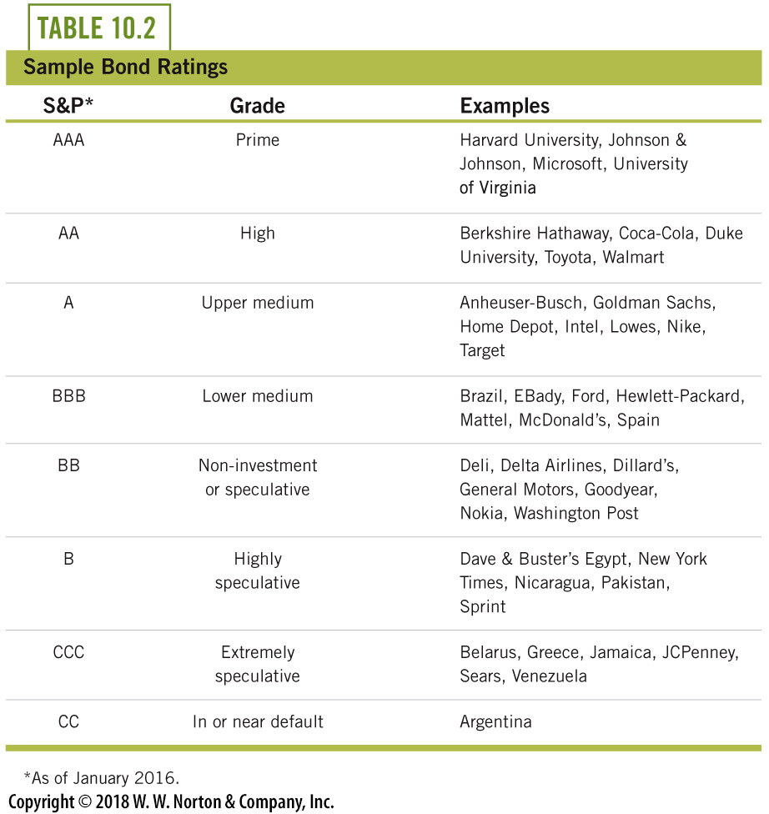
Bond Ratings and Default Risk

Slide 22
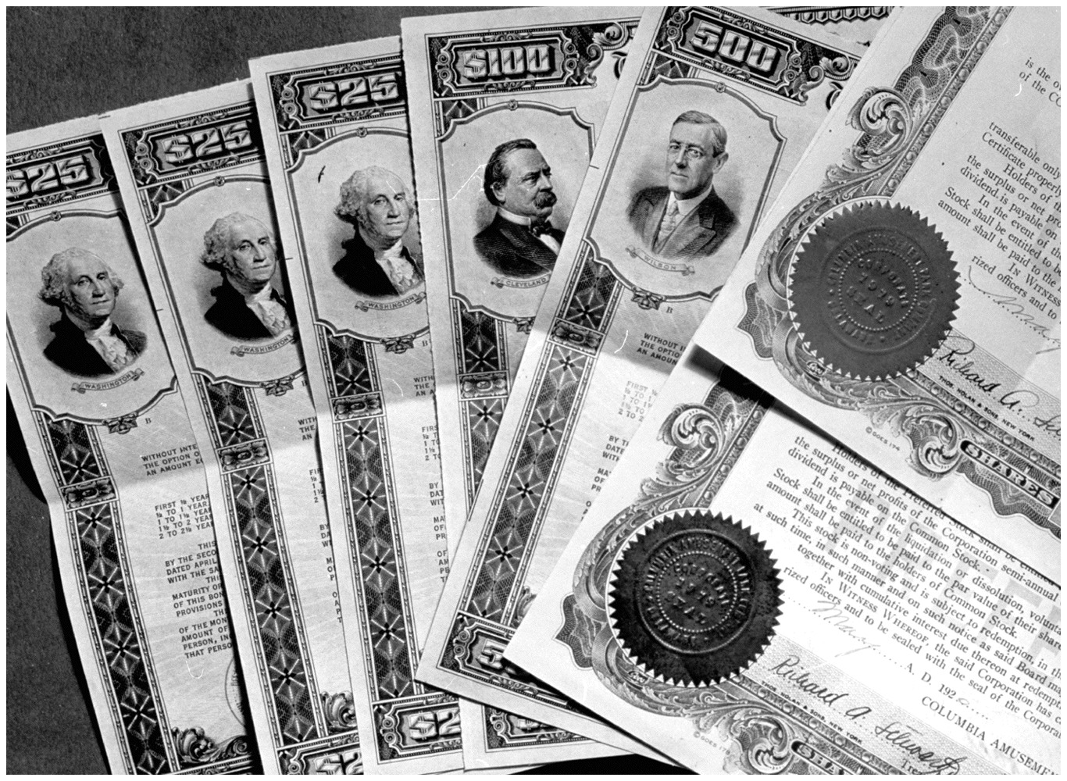
Stocks
Stock shares
  Ownership shares in the firm
  Shareholders have some influence in the operations of the firm
    If a shareholder owns more than 50% of the shares, they control more than 50% of the ownership votes.
  Firms can sell shares and move forward without the burden of debt from having to pay back a bond in the future
Notes:
Lecture notes:
Why would a firm sell stocks, instead of bonds?
Bond financing means the firm has a lot of bills that must be paid.
When IBM sells $10 million in 10-year bonds, that leads to a new obligation on their part—they have to pay $10 million in ten years.
If these bills are unpaid (the firm defaults on their bonds), the owners of the firm may need to declare bankruptcy and lose the firm altogether.
But with stocks, the owners can sell shares of the firm to others and move forward without the burden of debt from bonds.
When a firm sells stocks, the stockholders take on the risk that if the firm falters, the price of the shares they own will decrease.

Slide 23
Practice What You Know—5
What is an advantage of a firm selling stocks instead of selling bonds?
  Bonds are usually sold by new companies, and stocks make a firm seem established.
  Stocks are only sold once at the initial public offering.
  Firms can manipulate stock prices easily.
  Stocks don’t burden the firm with future debts that must be paid.
Notes:
Clicker question:
Correct answer: D, Stocks don’t burden the firm with future debts that must be paid.
With a bond, you have to pay it back at some later date.
You don’t have to do this with a stock.
Rather, the stock owner is now part owner of the company.

Slide 24

Secondary Markets
Secondary markets
  Where securities are traded after their first sale
  Analogous to used car markets
  Often sold to investors through a broker
  Enable firms to sell bonds at higher prices (lower interest rates) since demand for assets increases when they can be resold
Stock markets are secondary markets
  New York Stock Exchange (NYSE)
  National Association of Securities Dealers Automated Quotations (NASDAQ)
Notes:
Lecture notes:
A used security just means you are not buying the security directly from the firm whose name is on the security.
Secondary markets are important institutions that foster both direct and indirect investment.
The existence of secondary markets enables firms to sell their bonds at higher prices (lower interest rates), as demand for assets increases when they can be resold.

Slide 25
Secondary Markets Make Securities More Valuable
Notes:
Image: Animated Figure 10.5
Lecture tip:
Click through the slide so that each part of the graph appears.
First click: S
Second click: D₁
Third click: Dashed line for Q₁ and P₁
Fourth click: D₁ shifts right to D₂
Fifth click: Dashed line for Q₂ and P₂
Lecture notes:
The figure illustrates the impact that secondary markets have on security prices.
If a secondary market exists for a security, the demand for the security increases.
Consequently, the price of the security also increases, all else being equal.
For the firm, this is helpful as it lowers the interest rate it pays and, therefore, the cost of borrowing.

Slide 26
Economics in Margin Call
Margin Call (2011)
  Securities and stocks can be bought and sold on secondary markets
  But what if the seller knew something the buyer didn’t?
Notes:
“Economics in the Media” Slide
Lecture tip:
The clip mentioned on the slide can be found in the Interactive Instructor’s Guide. Access the direct link by clicking the icon in the PowerPoint above.
The key concepts covered in this clip are:
Marginal thinking
Financial crisis
Sunk costs
Cost-benefit analysis
Risk-taking
Moral hazard

Slide 27
Practice What You Know—6
Why is a secondary market for securities important?
  It increases the value of securities.
  It protects buyers from decreases in the value of the security.
  It decreases the incentive for people to sell and devalue securities.
  It encourages firms to sell only to the most responsible buyers.
Notes:
Clicker question:
Correct answer: A, It increases the value of securities.
Securities are more valuable when people know they can resell them someday.
Imagine if before buying an asset, you were told you could never sell it.
You would only buy it for a very low price, since it would be a risky purchase.

Slide 28
Two Special Debt Instruments
Treasury securities
  U.S. government borrows by selling Treasury securities
  An auction determines the interest rate
  Low risk
  Critical for monetary policy
  Active secondary market
Mortgages
  Individuals use loans to pay for homes (mortgage)
  Market expanded leading up to the 2008 recession
Notes:
Lecture notes:
Treasury Securities:
Governments also borrow a significant amount.
This includes state, local, and federal governments.
The U.S. federal government has over $14 trillion of debt—about $46,000 per citizen.
Our federal government utilizes the bond market for its borrowing.
The bonds the U.S. government sells are called U.S. Treasury securities.
Treasury securities have different names depending on the time to maturity (see https://www.treasurydirect.gov/indiv/products/products.htm).
Treasury securities are sold at auctions held in New York (see https://www.treasurydirect.gov/indiv/products/prod_auctions_glance.htm).
Since no one expects United States to default, these securities are typically considered to be less risky.
These securities turn out to be very important in macroeconomics and finance.
Treasury securities play a central role in conducting monetary policy. (More details on this will follow in Chapters 17 and 18.)
Once the securities are issued, they can be bought and sold in secondary markets.
In 2011, approximately $4.5 trillion (about 32 percent) of U.S. federal debt was held by foreigners.
Mortgages:
Most individuals cannot finance a home purchase with cash.
So, people must take out loans to buy a home. This type of loan is called a mortgage.
The most common mortgage loan lasts 30 years from inception and is paid off with 360 monthly payments over the course of 30 years.
Each month, the homeowner pays back part of the principal (the amount borrowed) plus interest.
Historically, fixed-rate mortgages are the most popular type of home loan, meaning that the interest rate is constant over time.
However, mortgage patterns did change during the early 2000s leading up to the 2008 recession.
You can think of mortgages as a variation on bonds.
A family wants to buy a home, so they take a mortgage loan—it is just like selling a bond.
Sources:
https://www.treasurydirect.gov/indiv/products/products.htm
https://www.treasurydirect.gov/indiv/products/prod_auctions_glance.htm

Slide 29
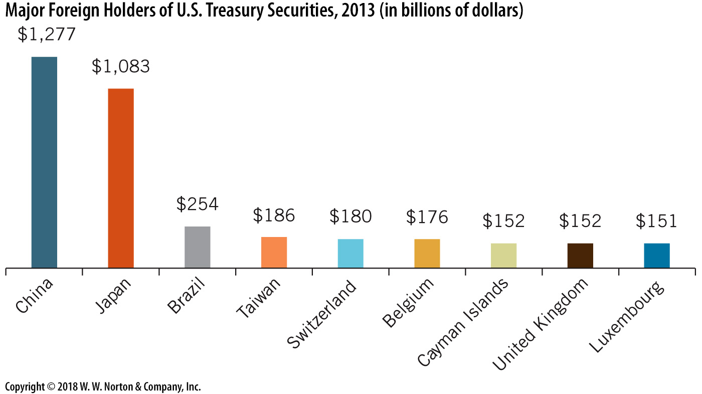
Major Foreign Holders of U.S. Treasury
Notes:
Image: Figure 10.6
Lecture notes:
There are times, in the midst of heated political debate, that politicians threaten actions that would lead to U.S. default on government bonds.
But this is generally considered political rhetoric.
Given the current state of the world economy, where foreign governments own billions of dollars in U.S. Treasury securities, it would almost certainly lead to a global financial meltdown if the U.S. defaulted on Treasury debt.
Politically, many people are concerned about China owning too much American debt.
Foreigners hold approximately 30 percent of U.S. government debt.
China owns about 7 percent of total U.S. debt ($1.3 billion of the $18 trillion).
Source: U.S. Treasury Department

Slide 30
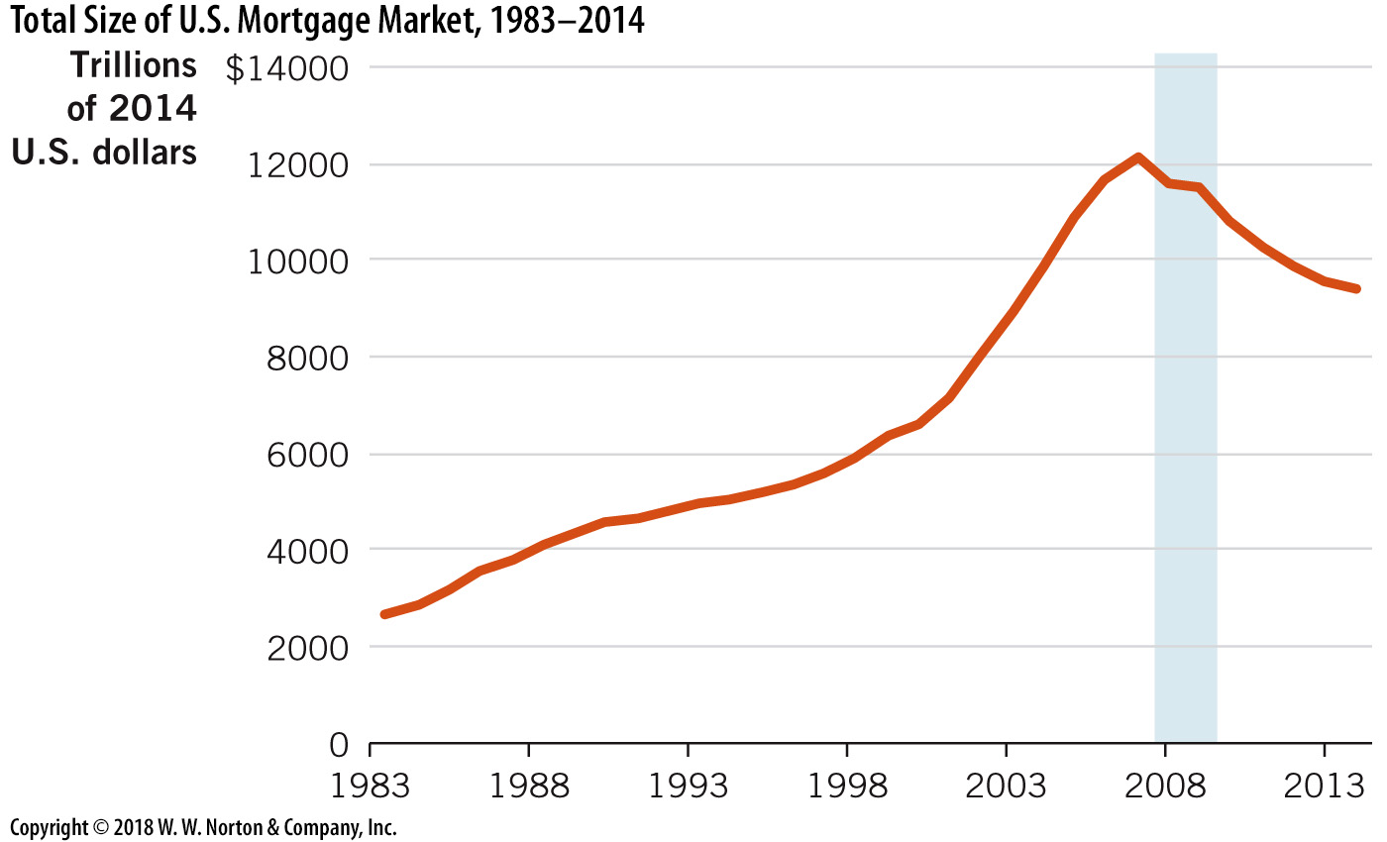
The U.S. Mortgage Market Expanded Rapidly before 2008
Notes:
Image: Figure 10.7
Lecture notes:
The home mortgage market in the United States expanded greatly leading up to the recession in 2008.
In 1982, there was about $2.2 trillion dollars in home mortgages in the United States.
But by 2008, this expanded to over $11 trillion.
During and after the recession, the mortgage market began to fall sharply.

Slide 31
Securitization
Securitization
  The creation of a new security as a combination of other securities and loan agreements (or pieces of other securities)
  Diversifies risk, lowers interest rates
  Offers new opportunities for lenders
  Student loan and home mortgage markets may not exist without the risk diversification of securitization
Notes:
Lecture notes:
Financial securities and other loan agreements (like student loans and home mortgages) channel funds from savers to borrowers.
Opportunities for both firms and individuals expand when credit is available.
Lower interest rates reduce the costs of borrowing.
When interest rates are lower, investment opportunities expand for everything from factories to roads to homes to education.
This is why secondary markets are so important: when securities are salable, they are more valuable and this reduces the interest rates for the underlying loans. This is true for any asset.

Slide 32
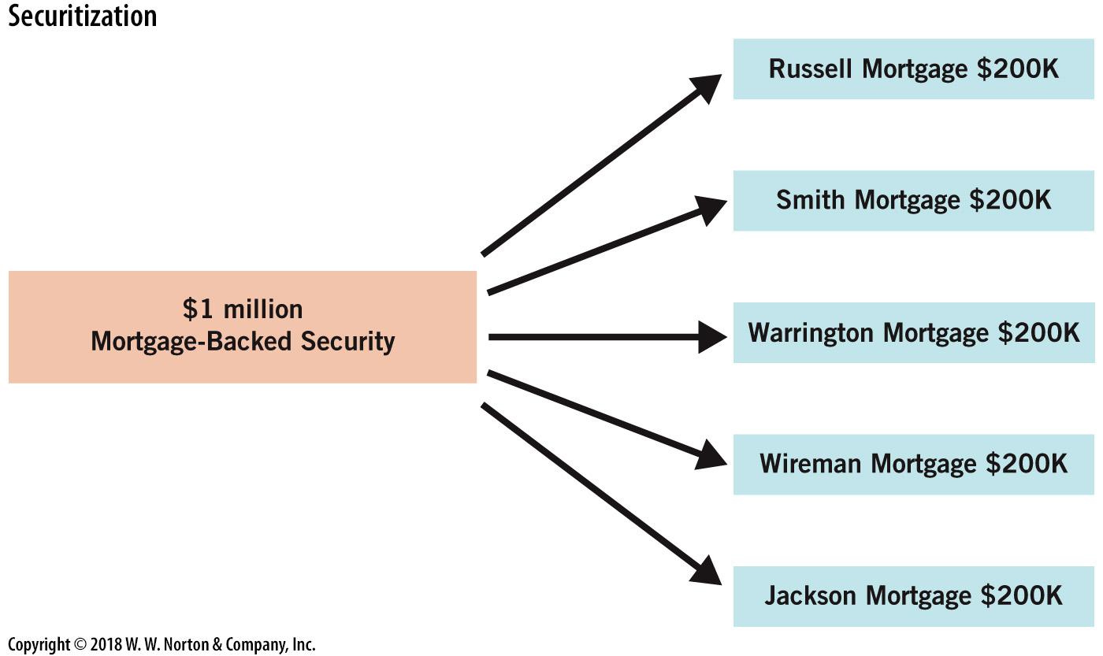
The New Security Is a Bundle of Other Loans
Notes:
Image: Figure 10.8
Lecture notes:
Mortgage-backed securities (MBS) are created through the process of securitization.
The figure on the slide illustrates how these securities are created.
Each MBS is a combination or bundle of mortgages.
The new security is more marketable since the default risk is diversified over several different mortgages.
In a few years, you may use a mortgage to buy a home.
After you do this, there is a chance your mortgage will be bundled together with others into a big security that can be bought and sold.
The mere existence of this market means you will pay lower interest rates than without this market.
Also, the market for MBS allows banks to make more loans and expand homeownership rates.

Slide 33
Conclusion
Indirect finance is when savers and lenders utilize banks in the market for loans
Direct finance is when borrowers go directly to lenders (stock or bond purchases)
Bonds are loan contracts that are typically traded in secondary markets
Stocks are ownership shares in firms
U.S. Treasury securities are the bonds used by the federal government to finance the national debt

